Slide 1
Understanding Deep Learning
Chapter 15: Generative adversarial networks
This work is subject to a Creative Commons CC-BY-NC-ND license. (C) MIT Press.

Slide 2
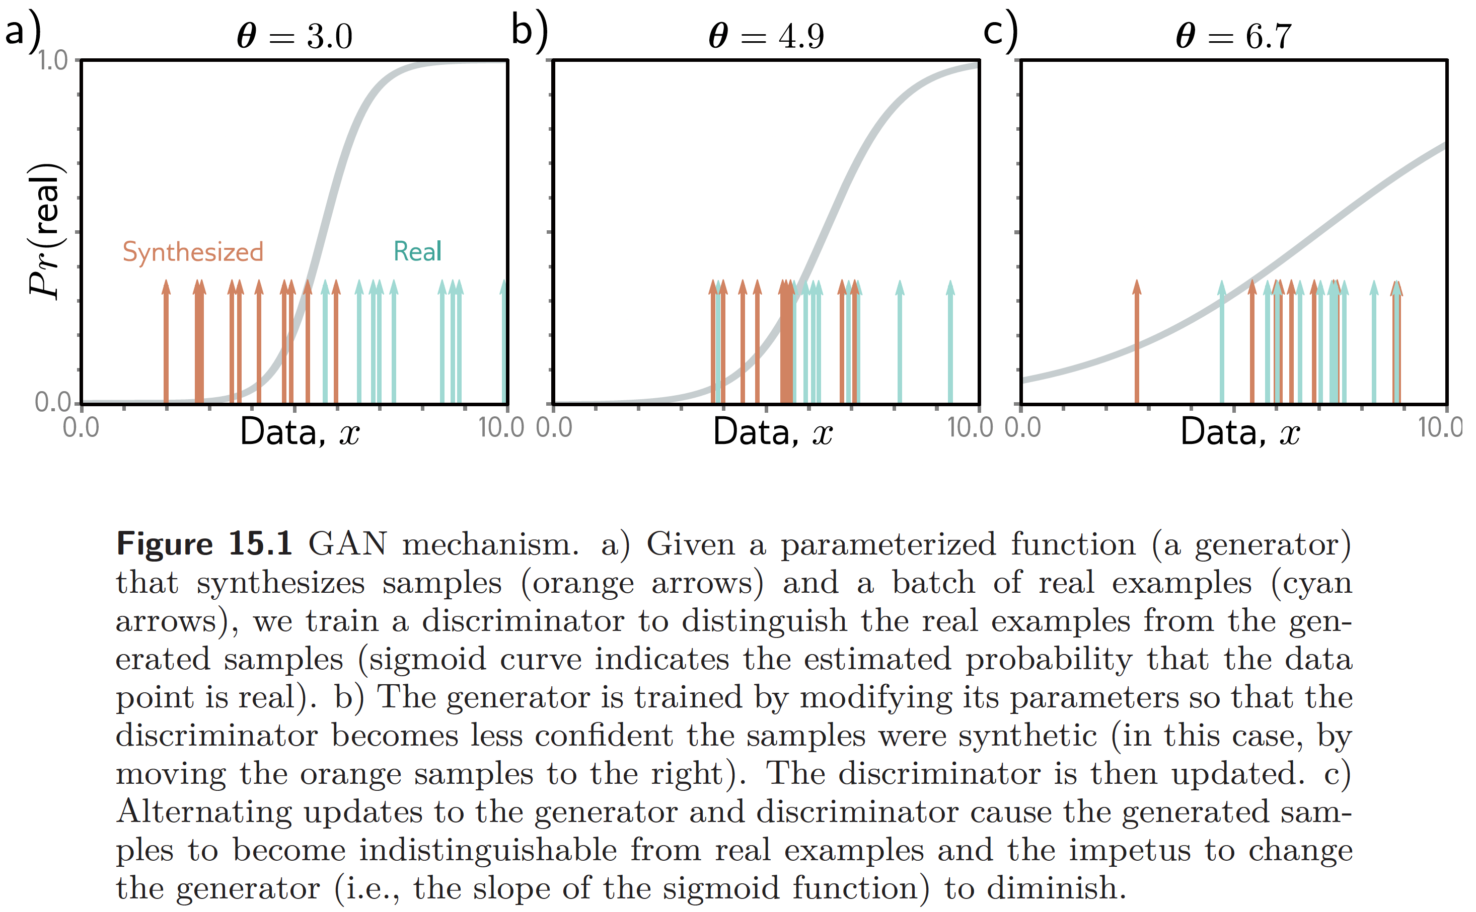
This work is subject to a Creative Commons CC-BY-NC-ND license. (C) MIT Press.

Slide 3
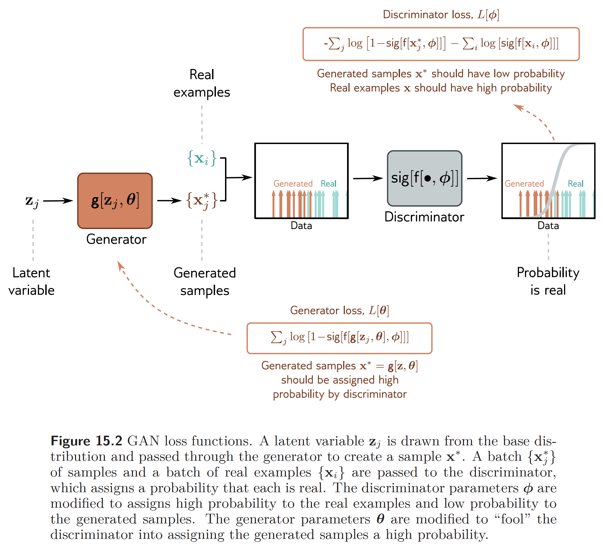
This work is subject to a Creative Commons CC-BY-NC-ND license. (C) MIT Press.

Slide 4
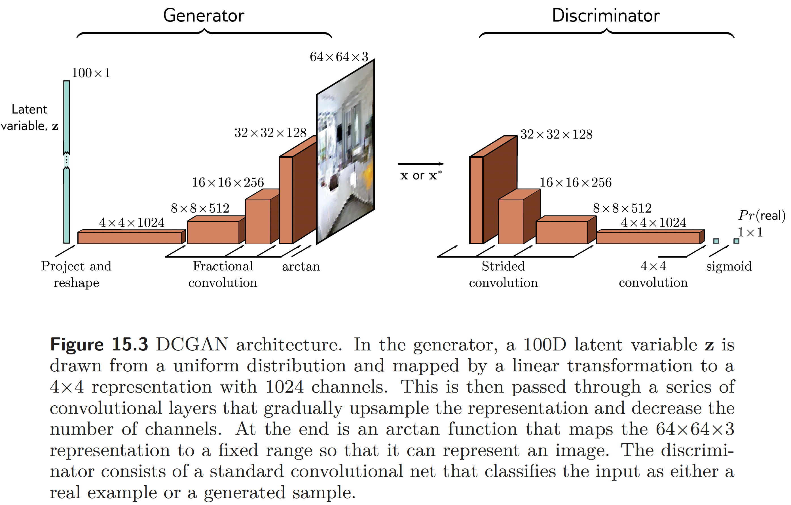
This work is subject to a Creative Commons CC-BY-NC-ND license. (C) MIT Press.

Slide 5
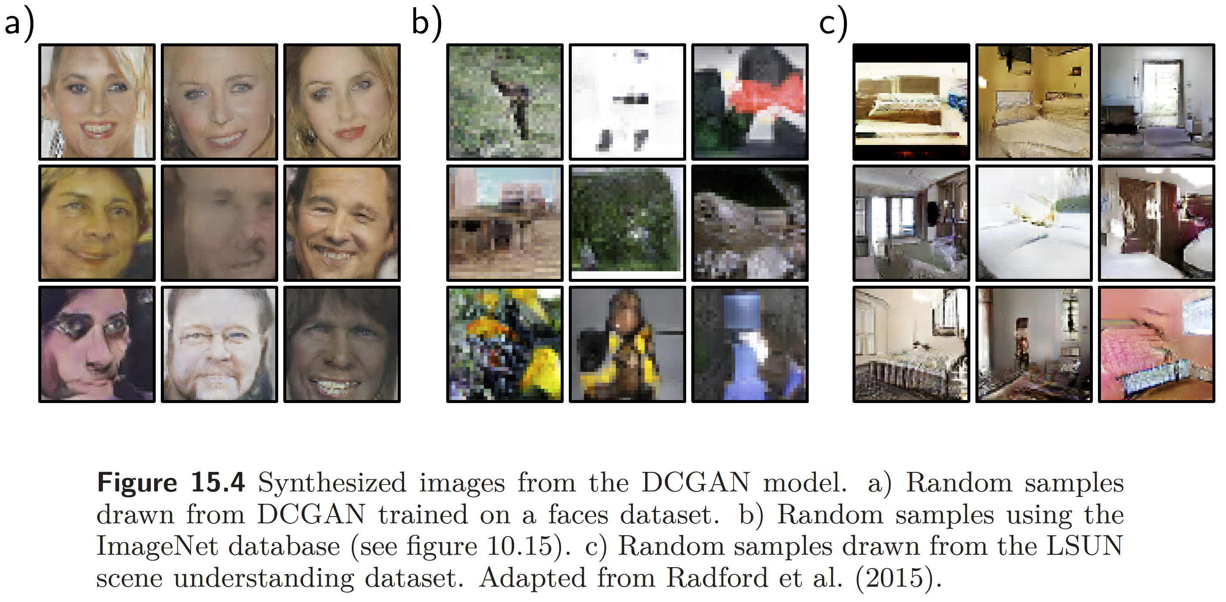
This work is subject to a Creative Commons CC-BY-NC-ND license. (C) MIT Press.

Slide 6
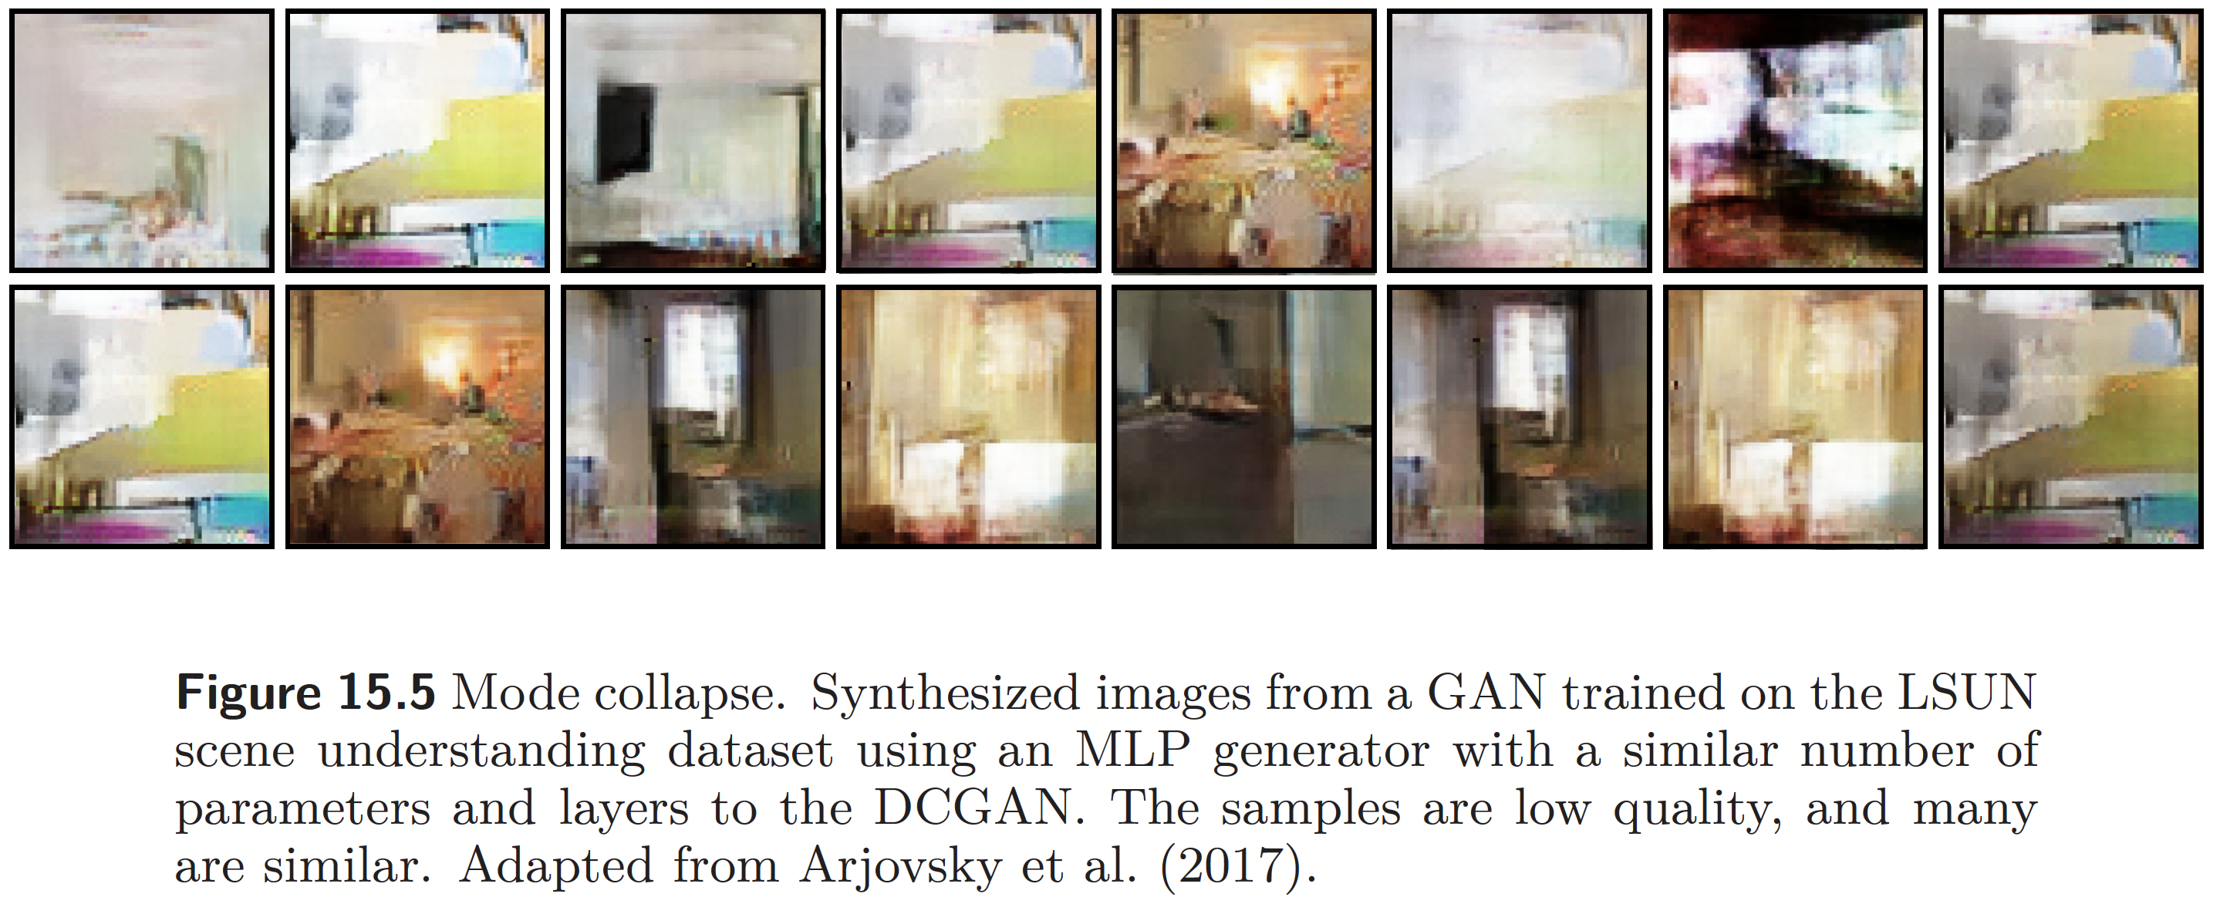
This work is subject to a Creative Commons CC-BY-NC-ND license. (C) MIT Press.

Slide 7
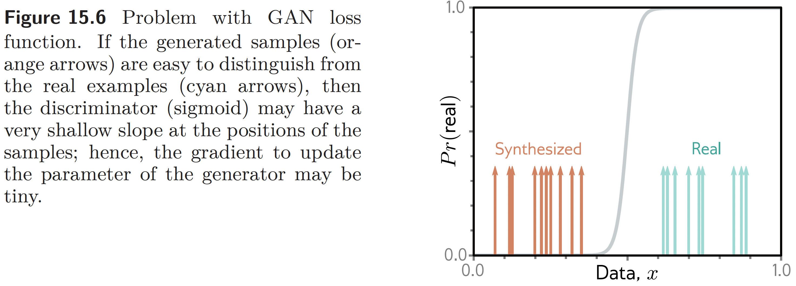
This work is subject to a Creative Commons CC-BY-NC-ND license. (C) MIT Press.

Slide 8
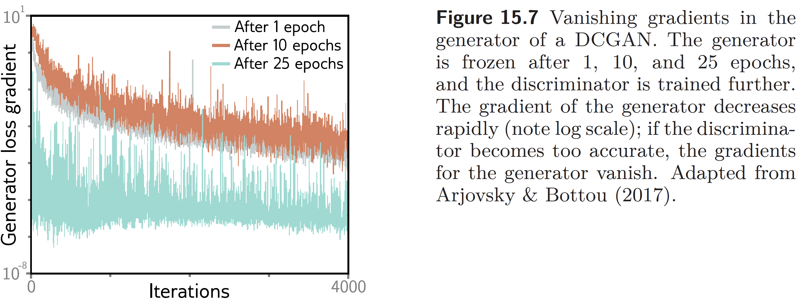
This work is subject to a Creative Commons CC-BY-NC-ND license. (C) MIT Press.

Slide 9
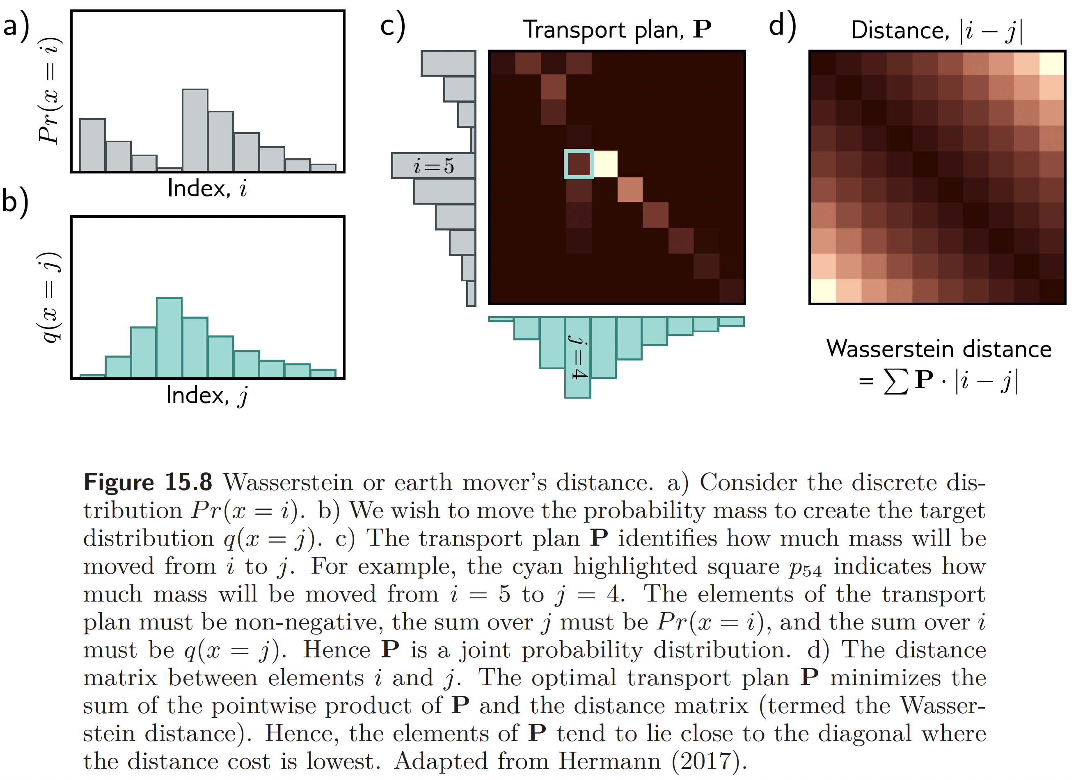
This work is subject to a Creative Commons CC-BY-NC-ND license. (C) MIT Press.

Slide 10
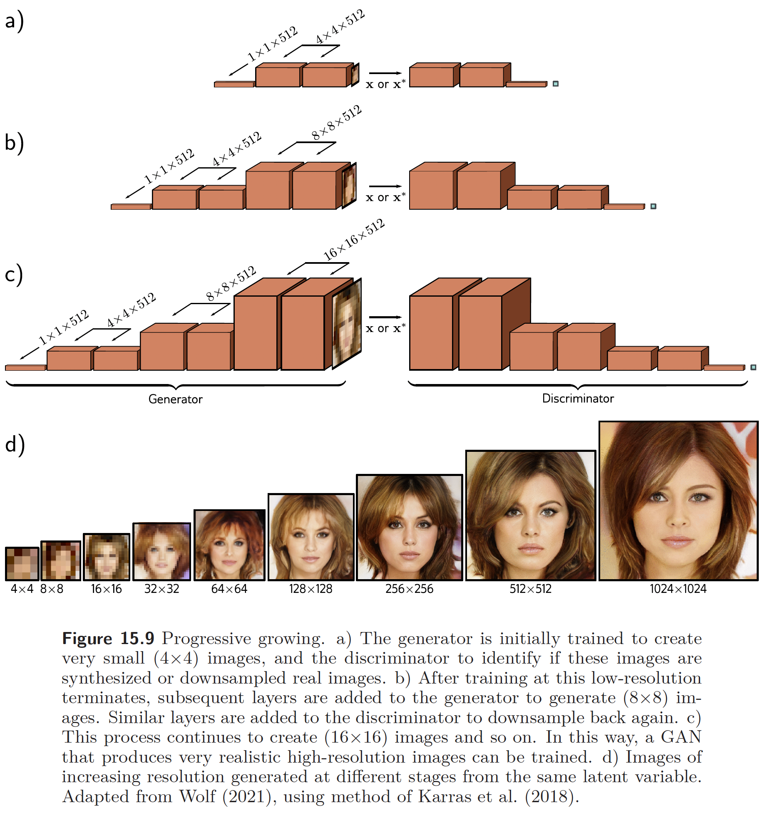
This work is subject to a Creative Commons CC-BY-NC-ND license. (C) MIT Press.

Slide 11
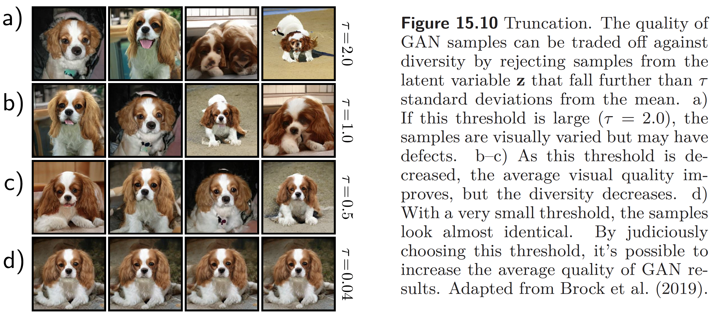
This work is subject to a Creative Commons CC-BY-NC-ND license. (C) MIT Press.

Slide 12
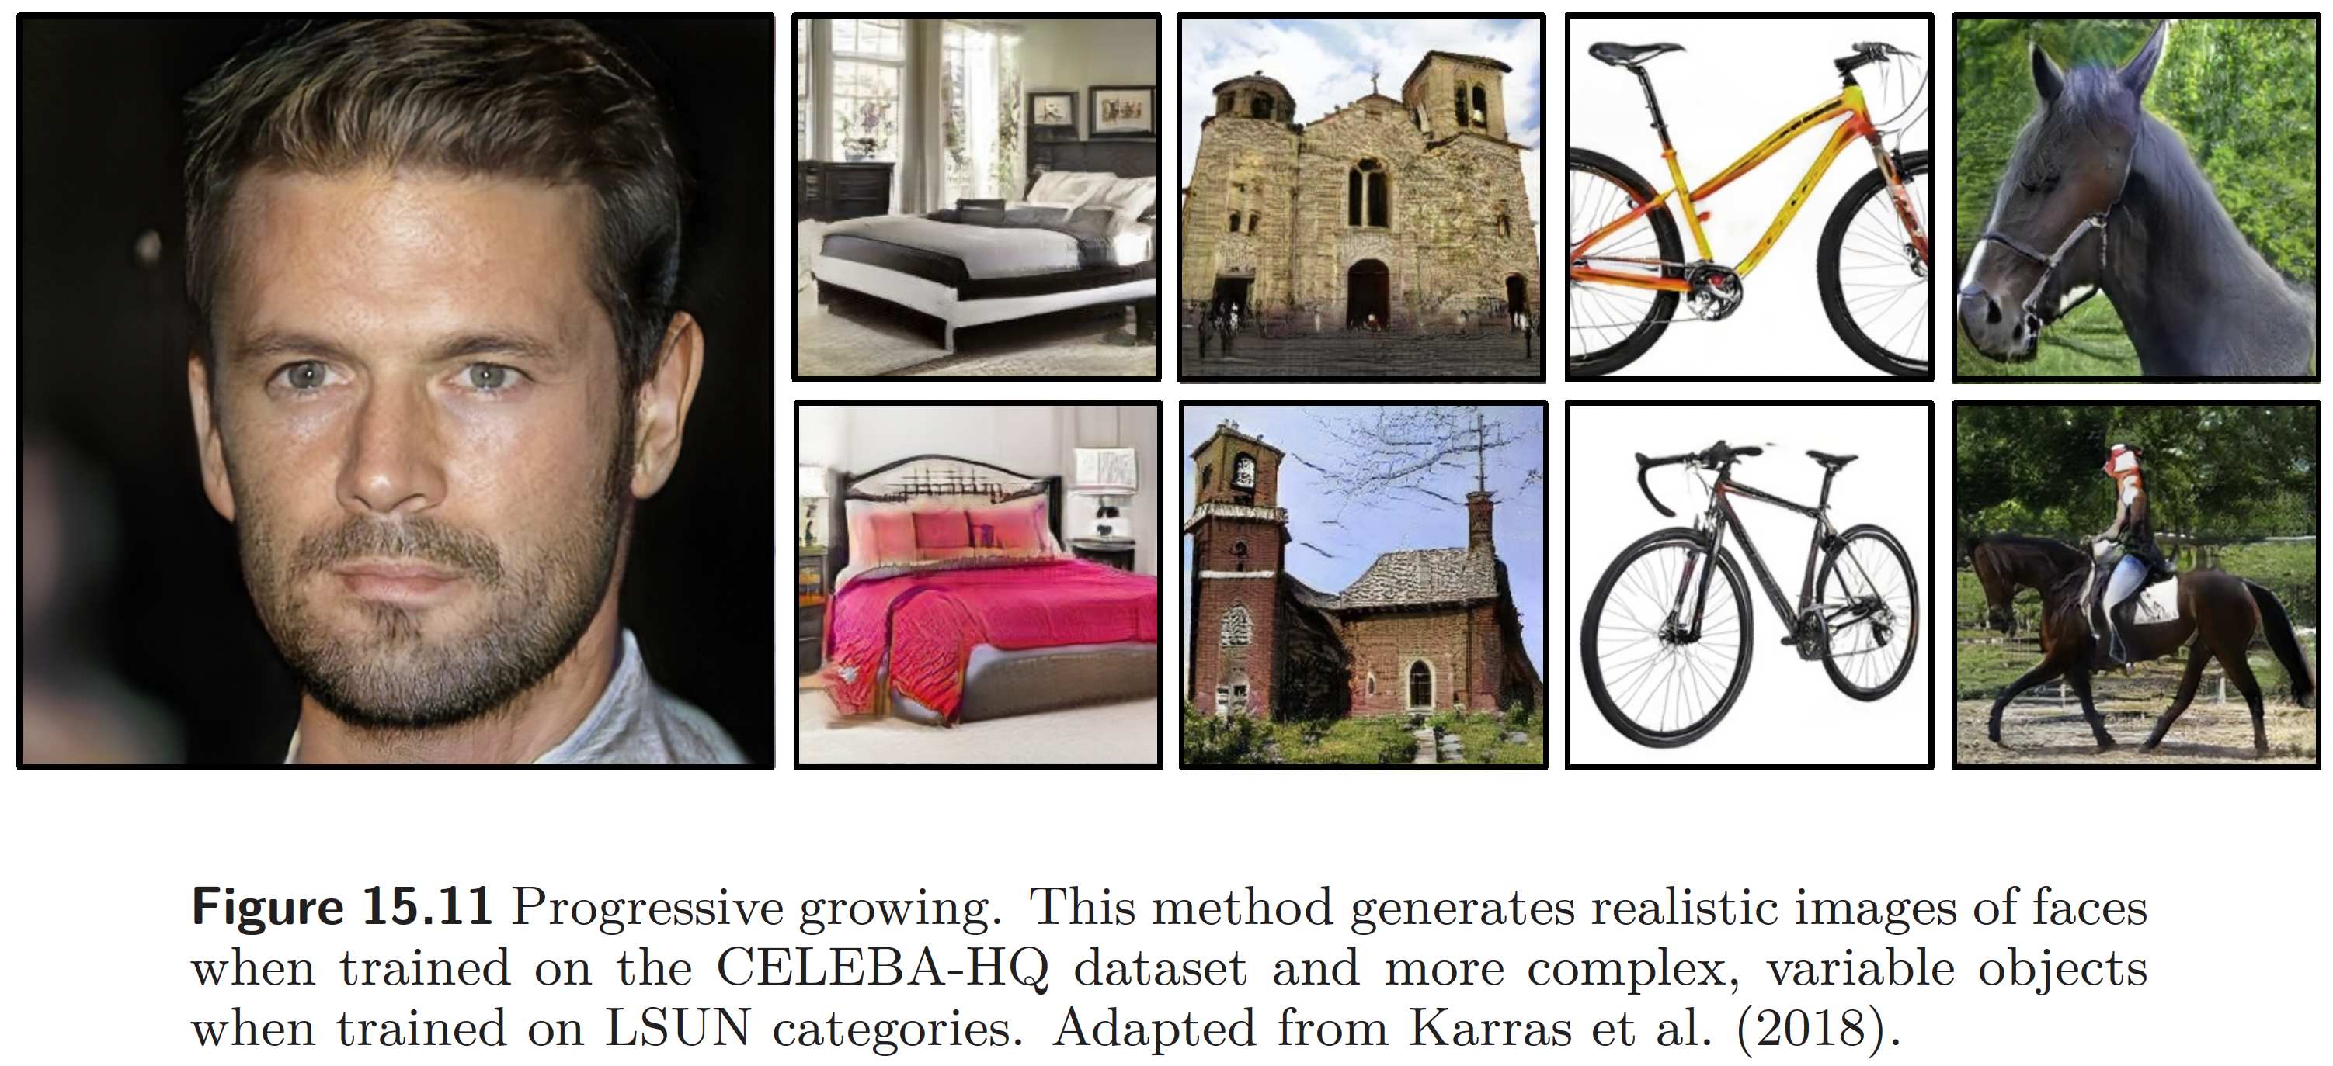
This work is subject to a Creative Commons CC-BY-NC-ND license. (C) MIT Press.

Slide 13
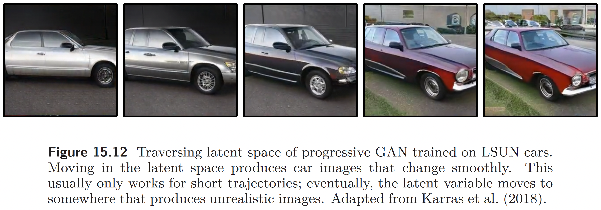
This work is subject to a Creative Commons CC-BY-NC-ND license. (C) MIT Press.

Slide 14
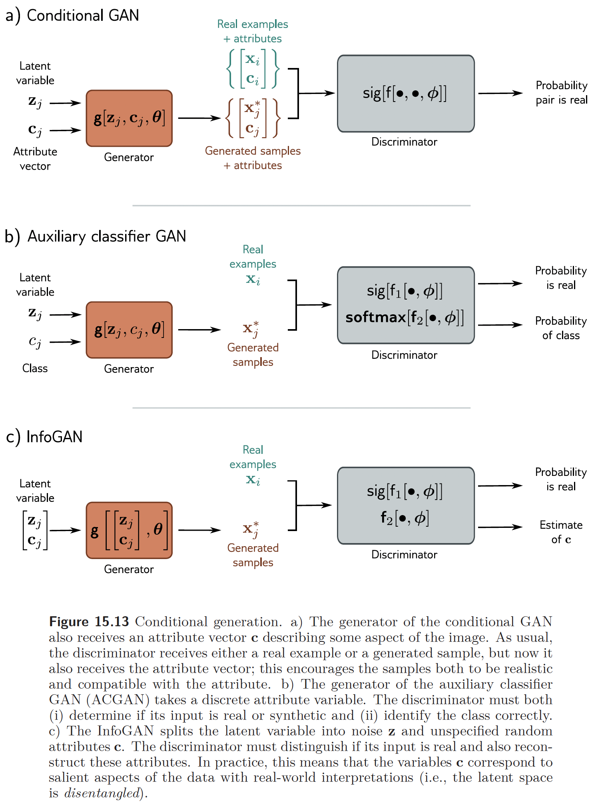
This work is subject to a Creative Commons CC-BY-NC-ND license. (C) MIT Press.

Slide 15
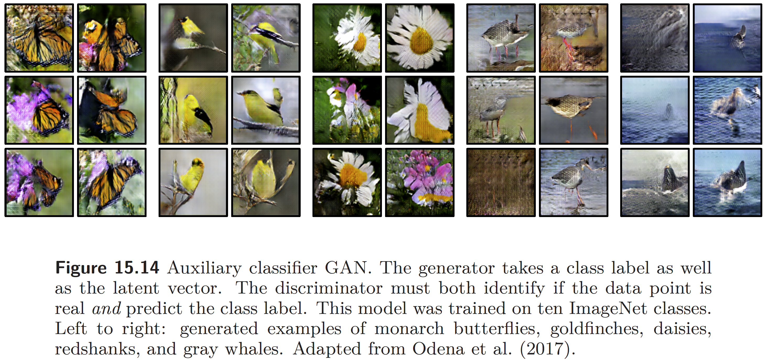
This work is subject to a Creative Commons CC-BY-NC-ND license. (C) MIT Press.

Slide 16
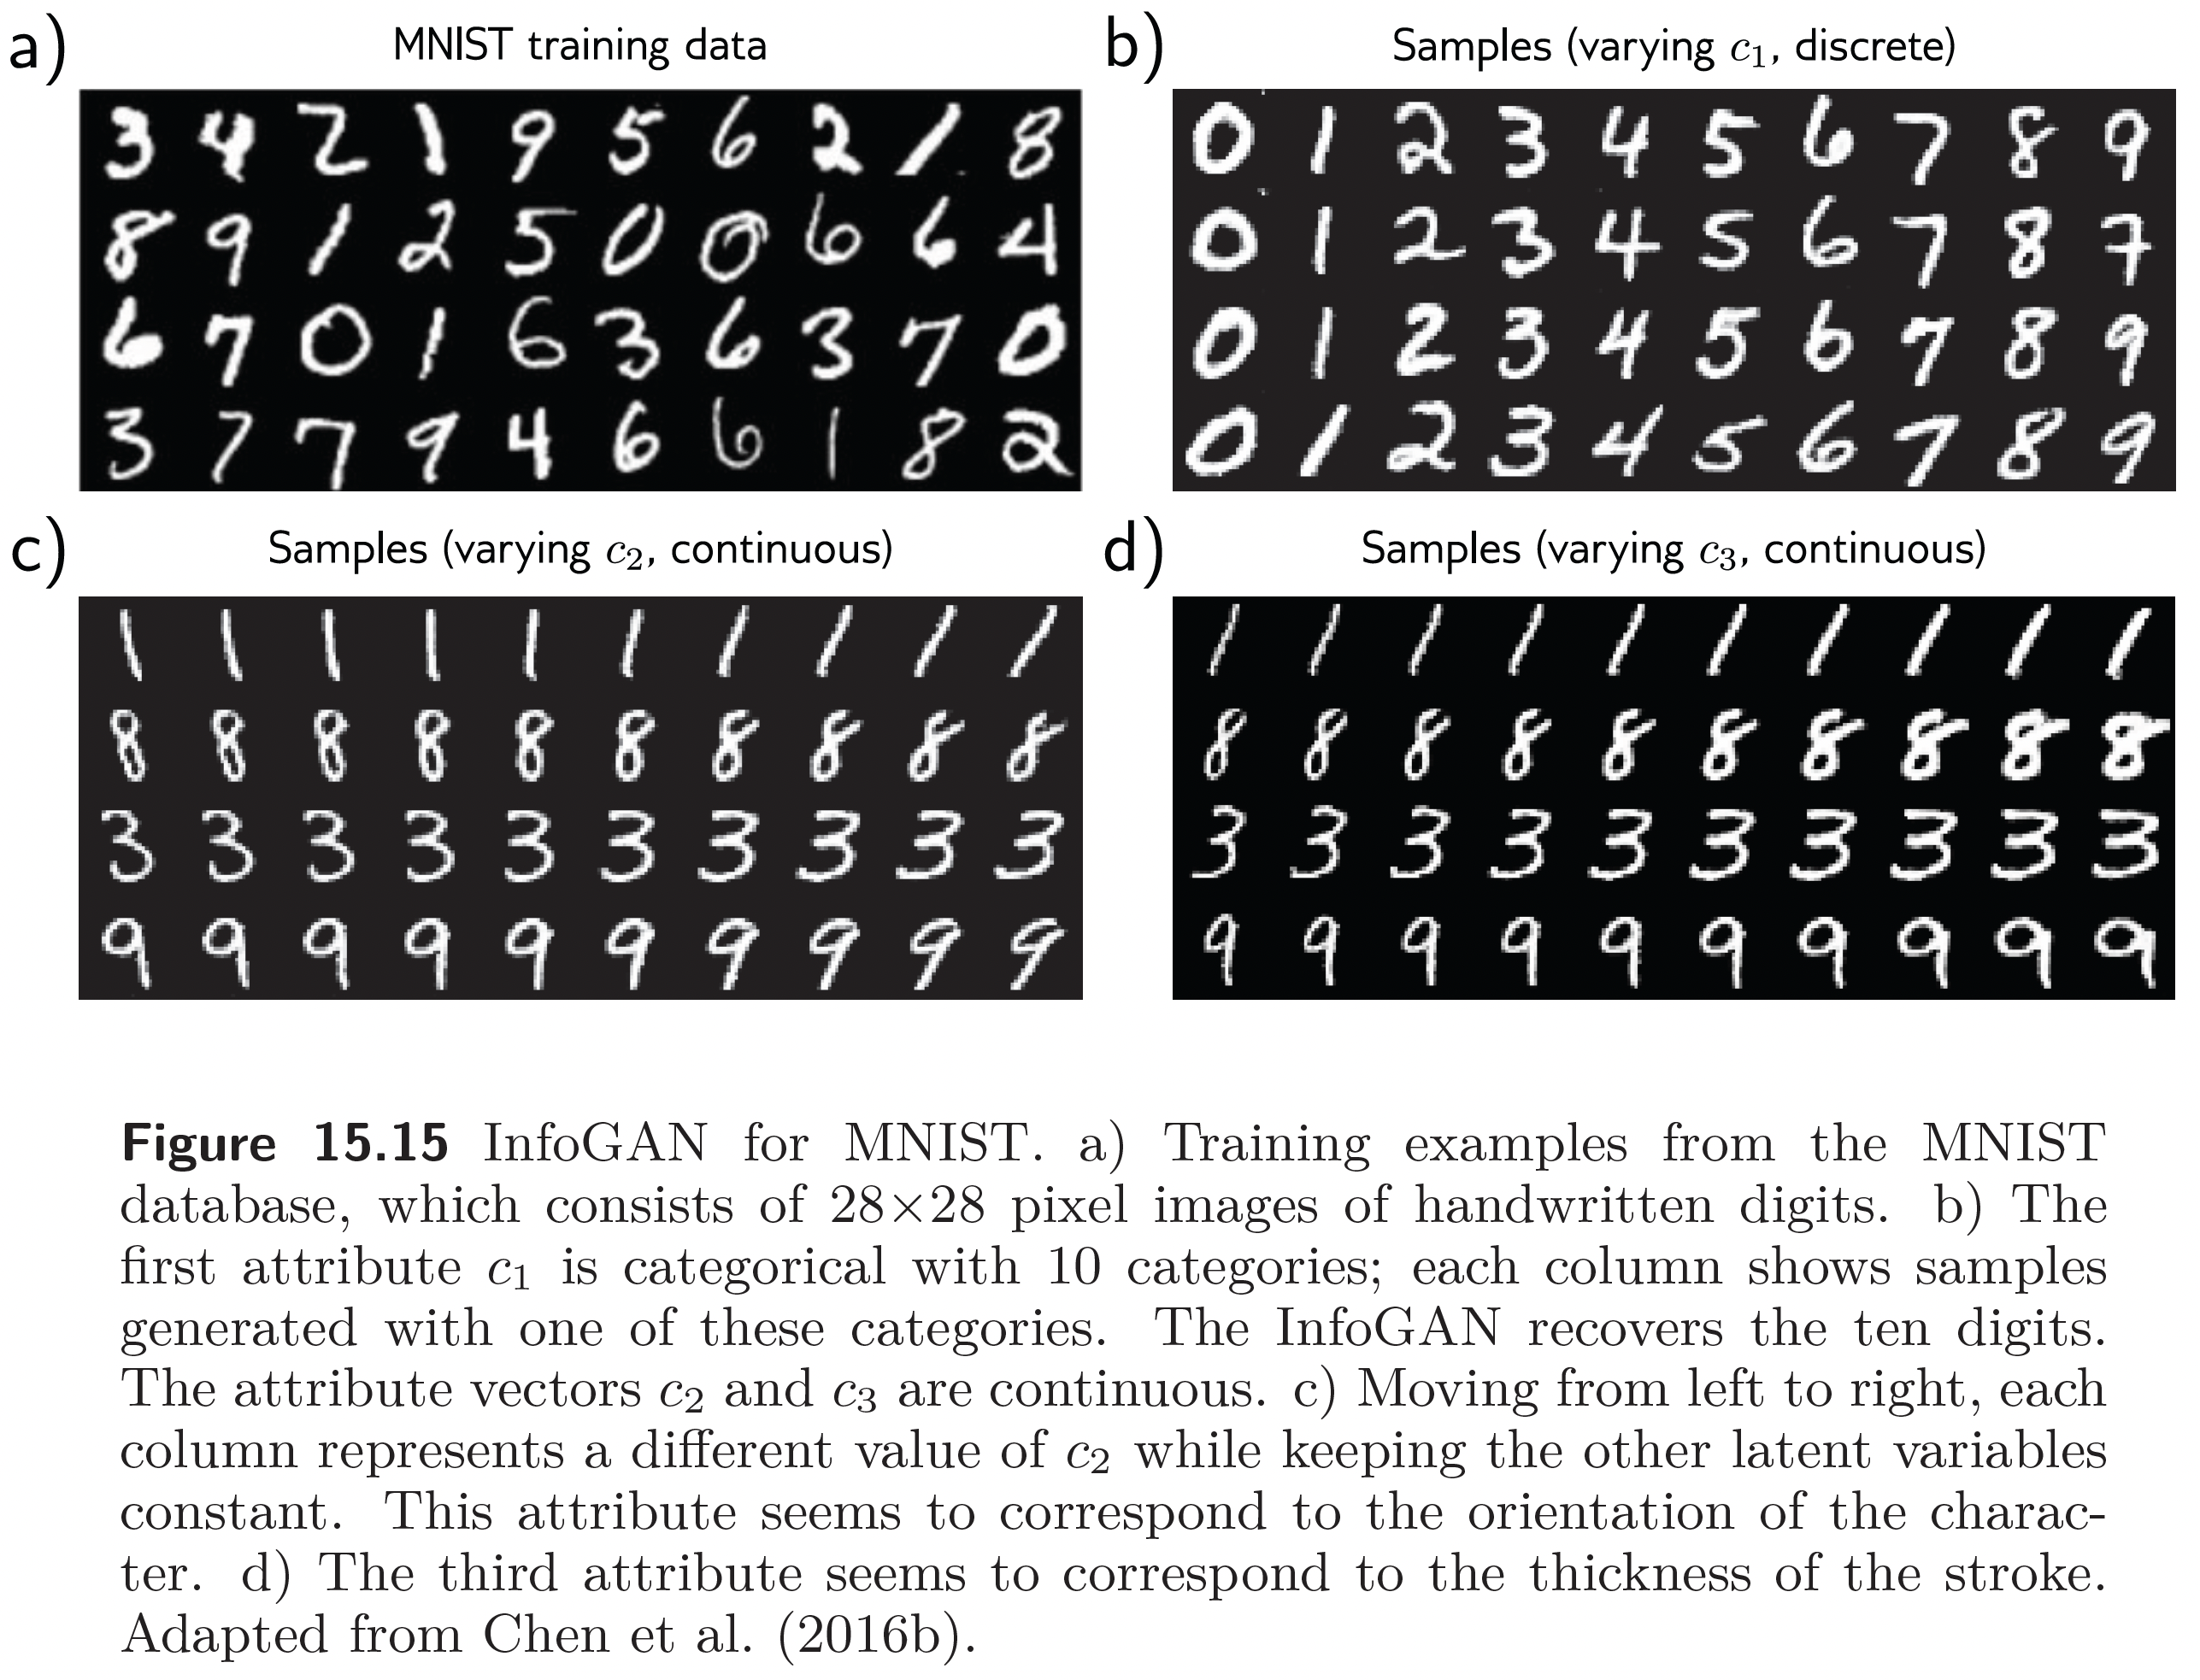
This work is subject to a Creative Commons CC-BY-NC-ND license. (C) MIT Press.

Slide 17
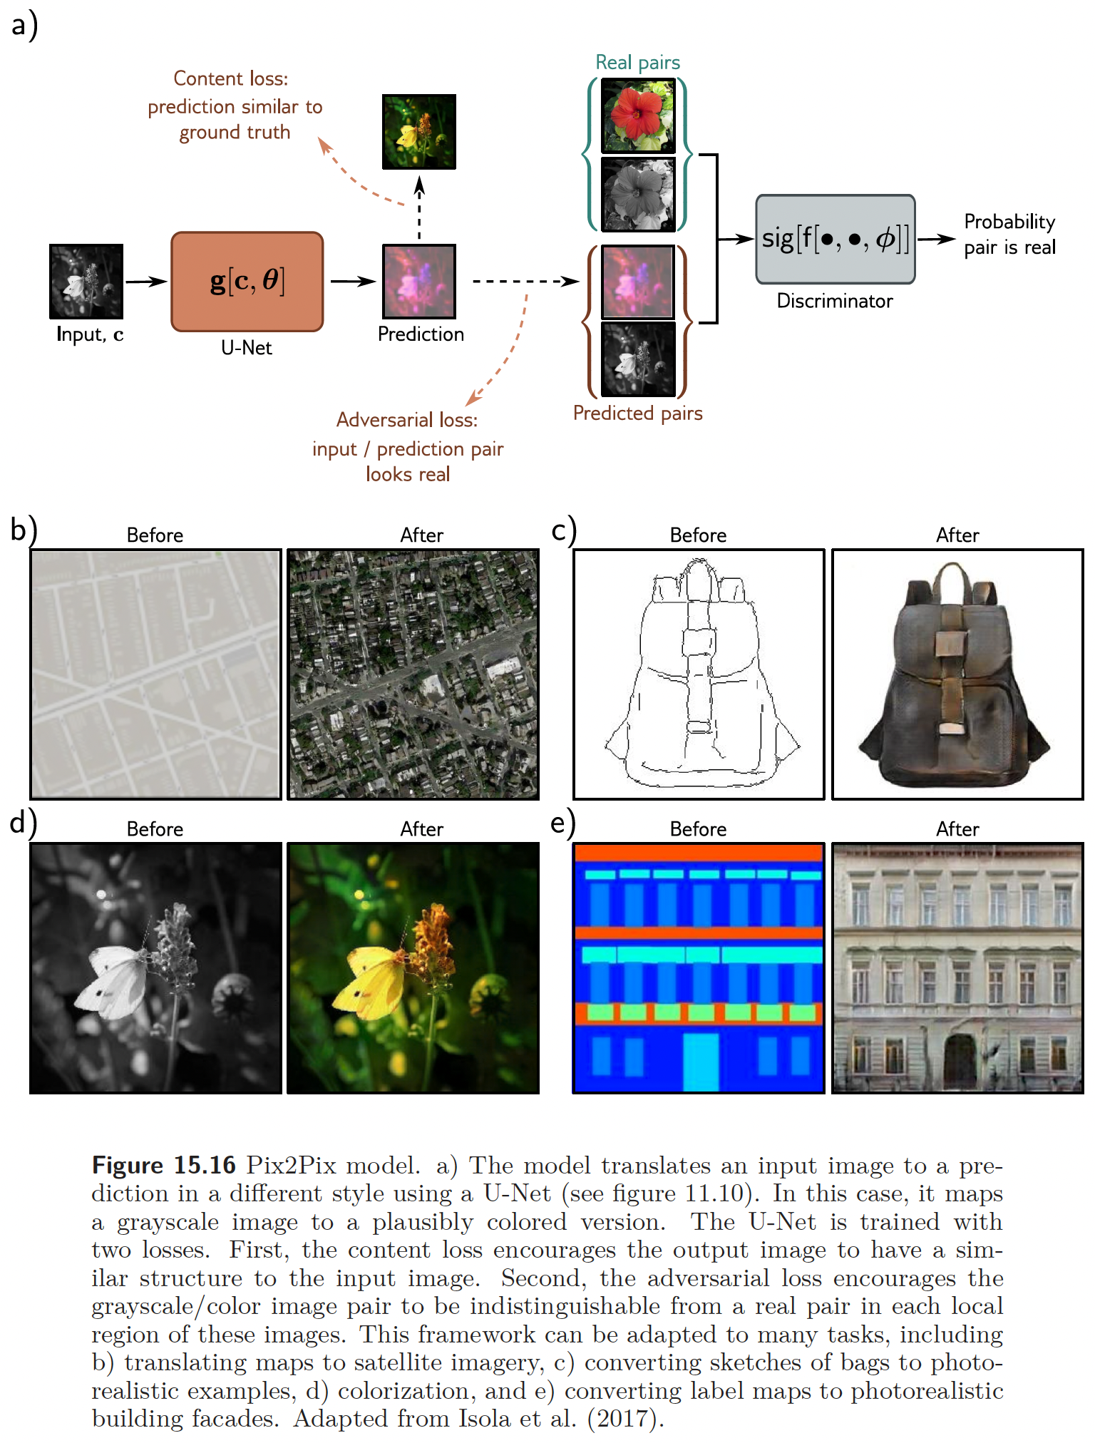
This work is subject to a Creative Commons CC-BY-NC-ND license. (C) MIT Press.

Slide 18
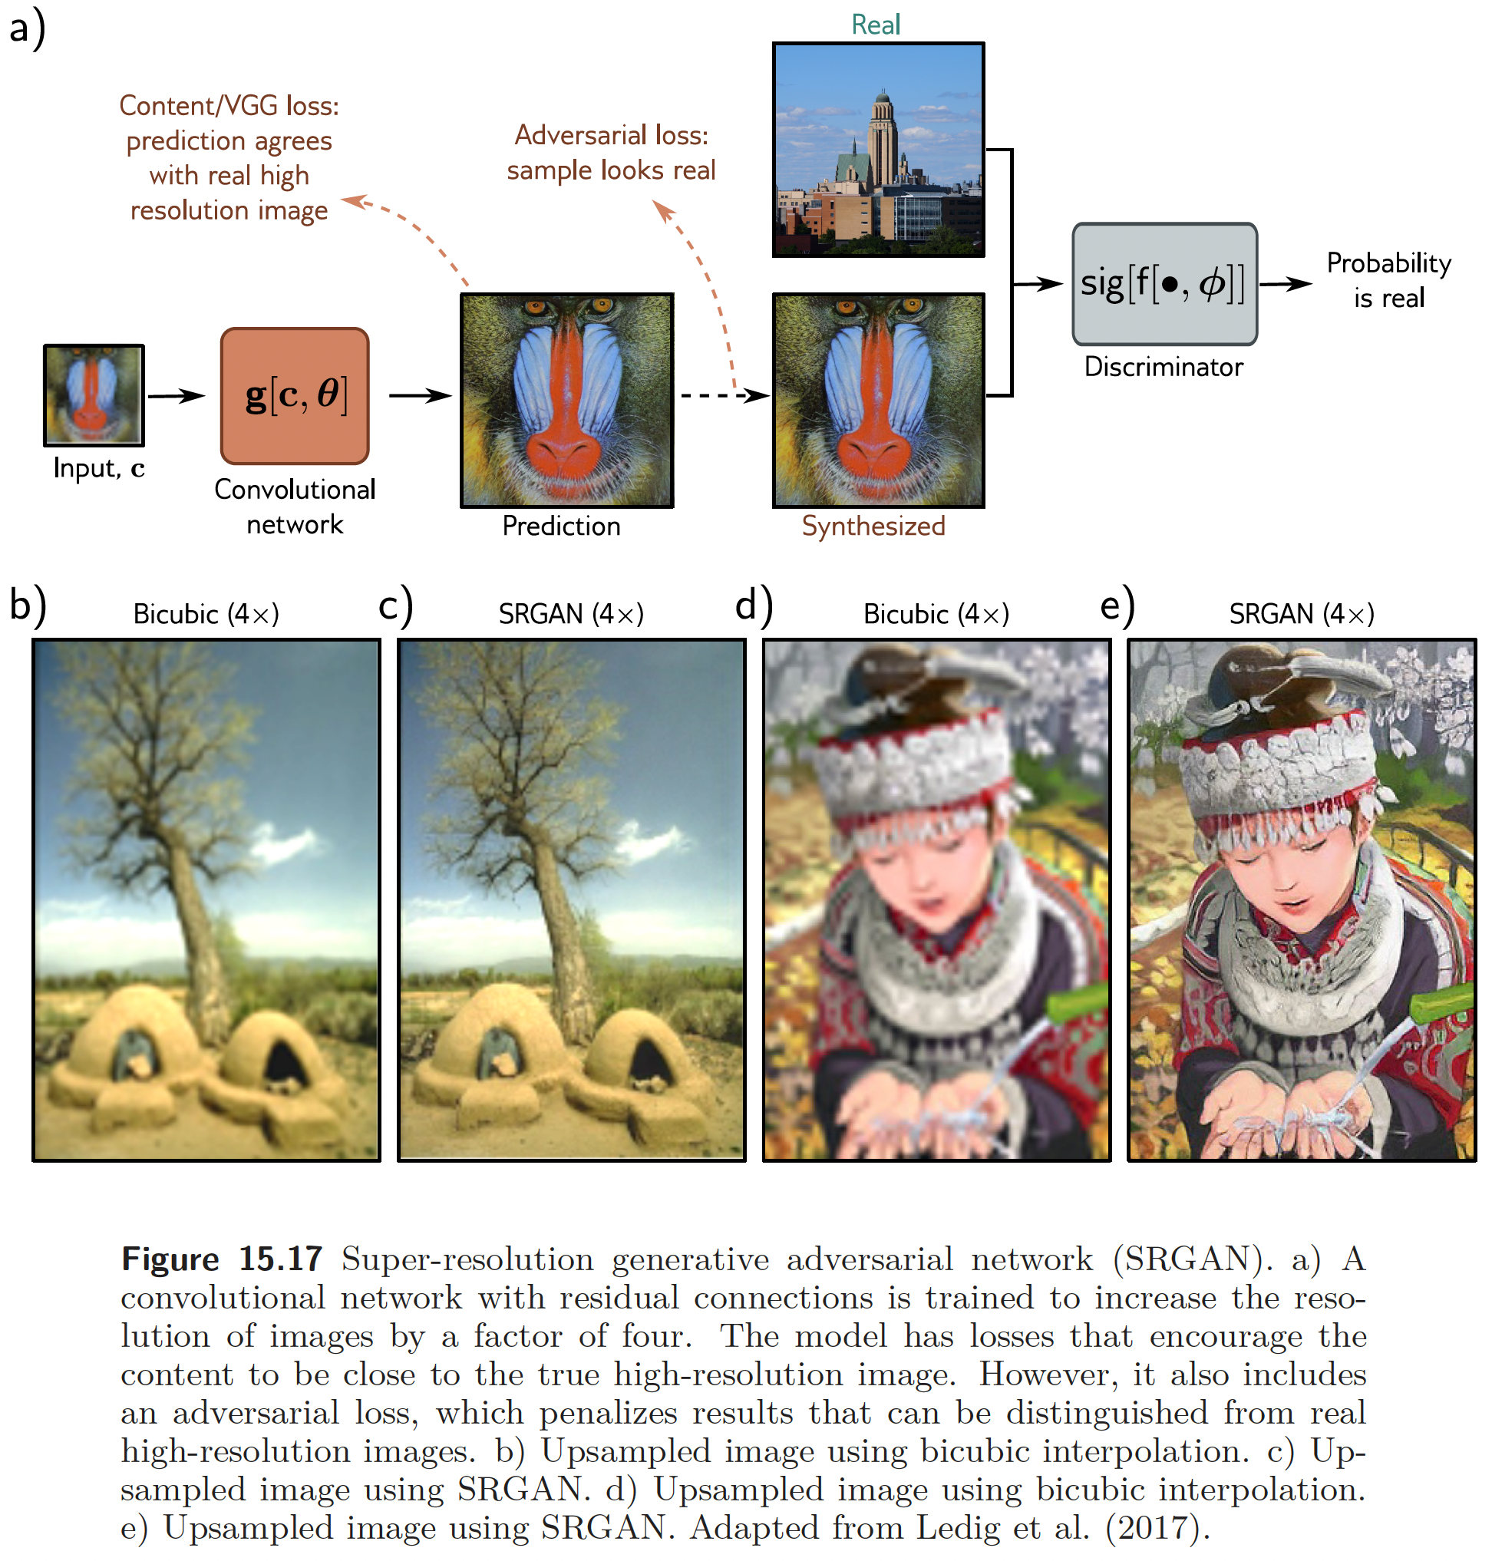
This work is subject to a Creative Commons CC-BY-NC-ND license. (C) MIT Press.

Slide 19
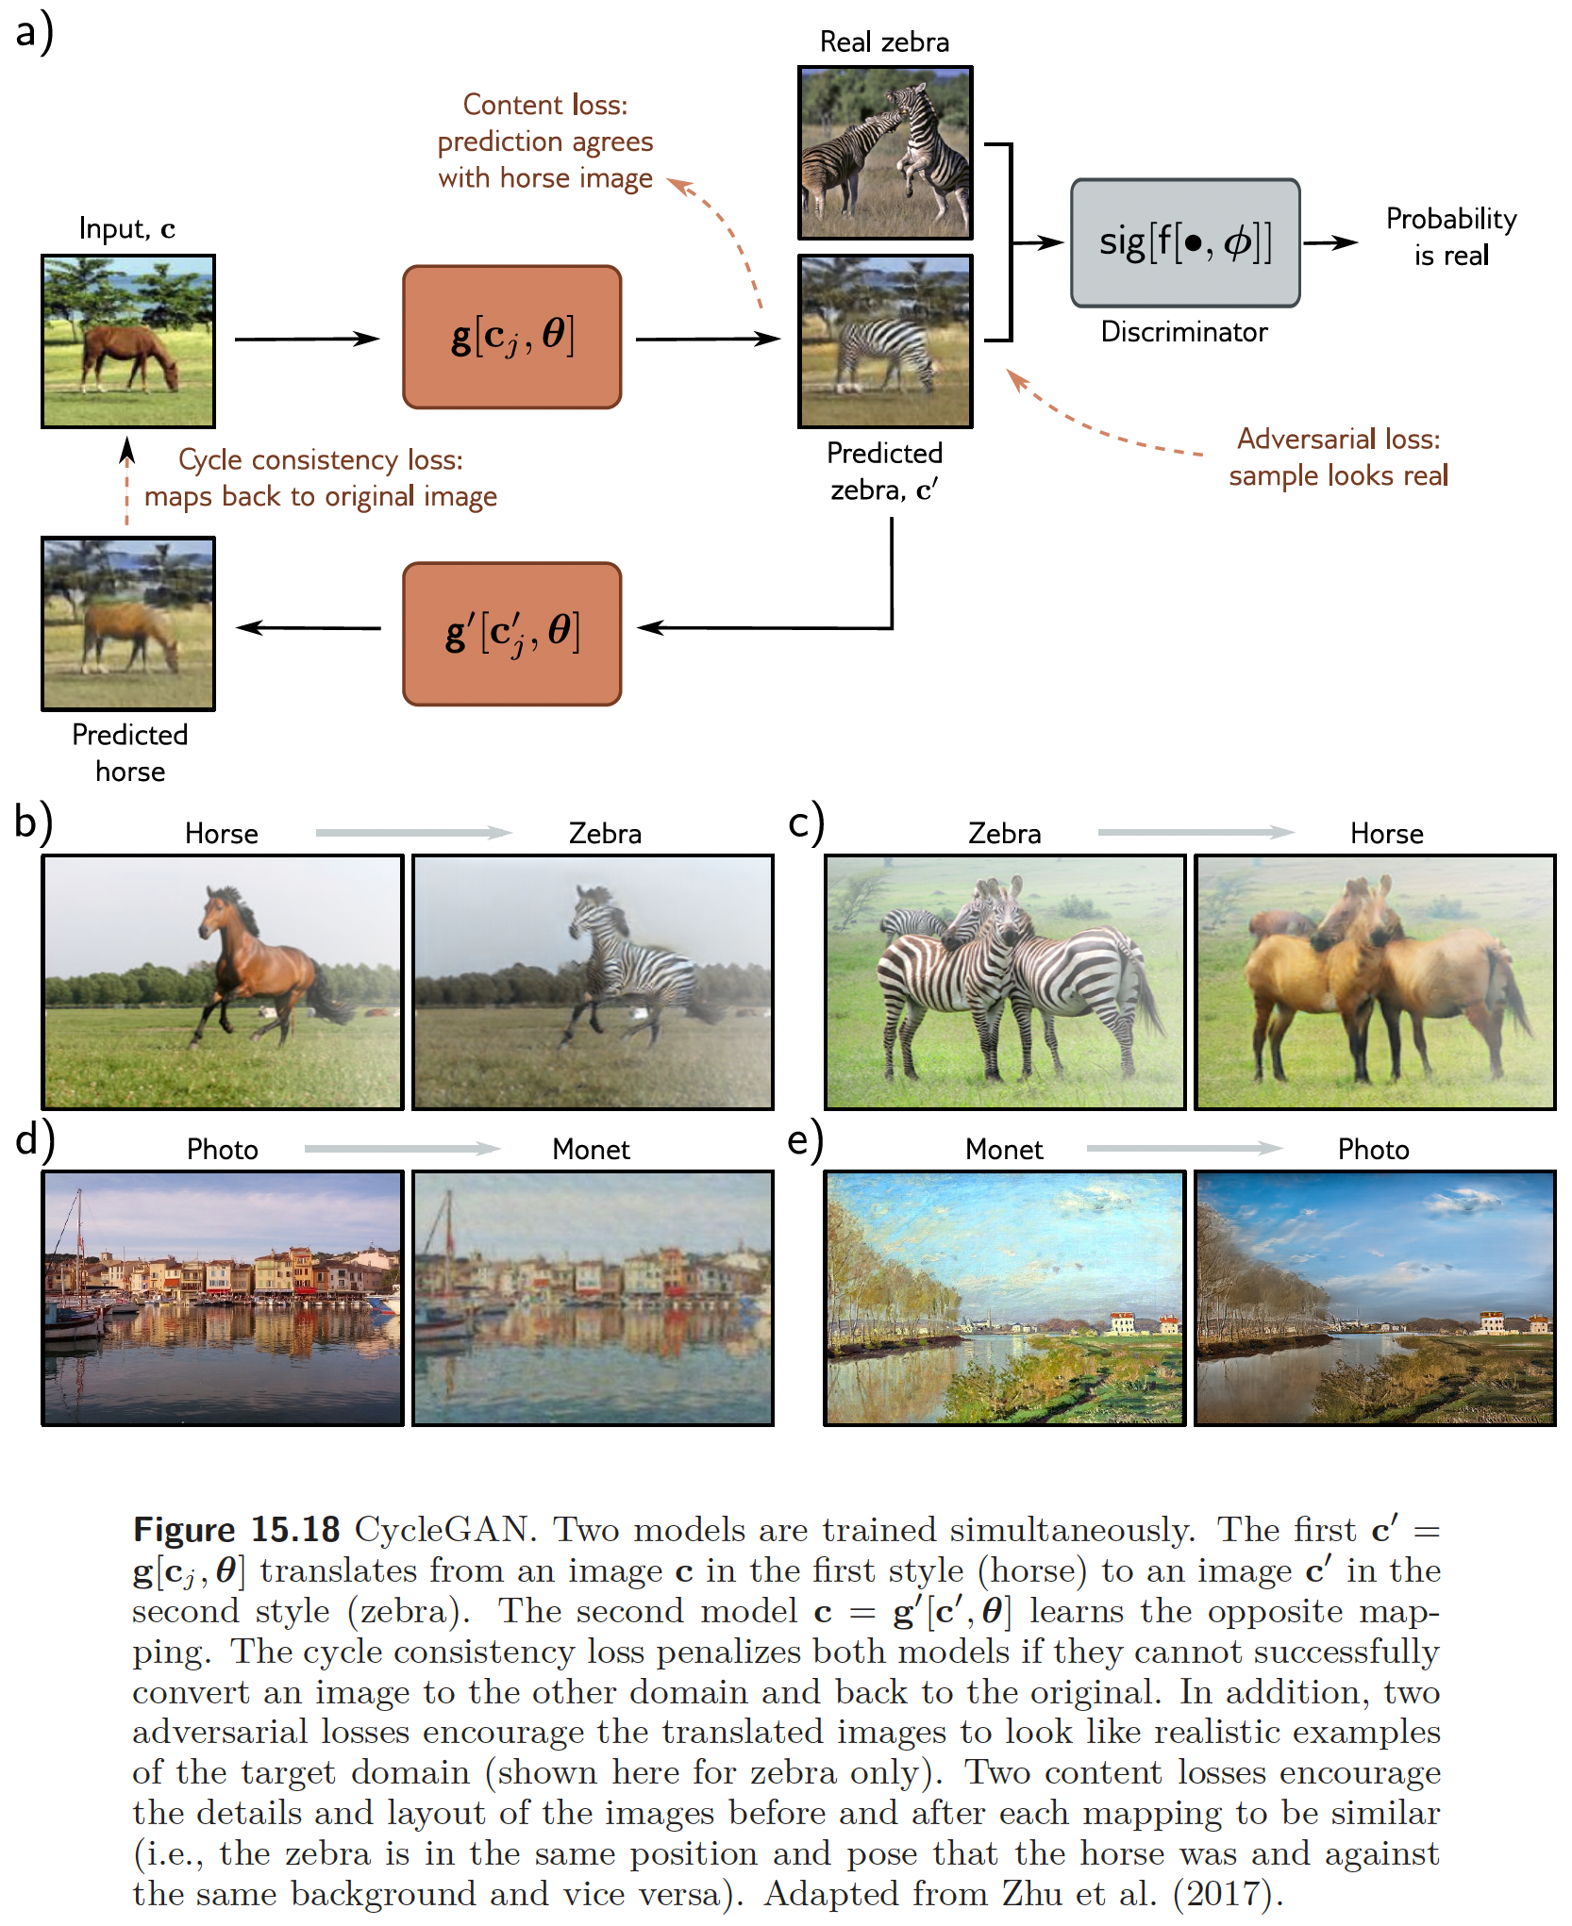
This work is subject to a Creative Commons CC-BY-NC-ND license. (C) MIT Press.

Slide 20
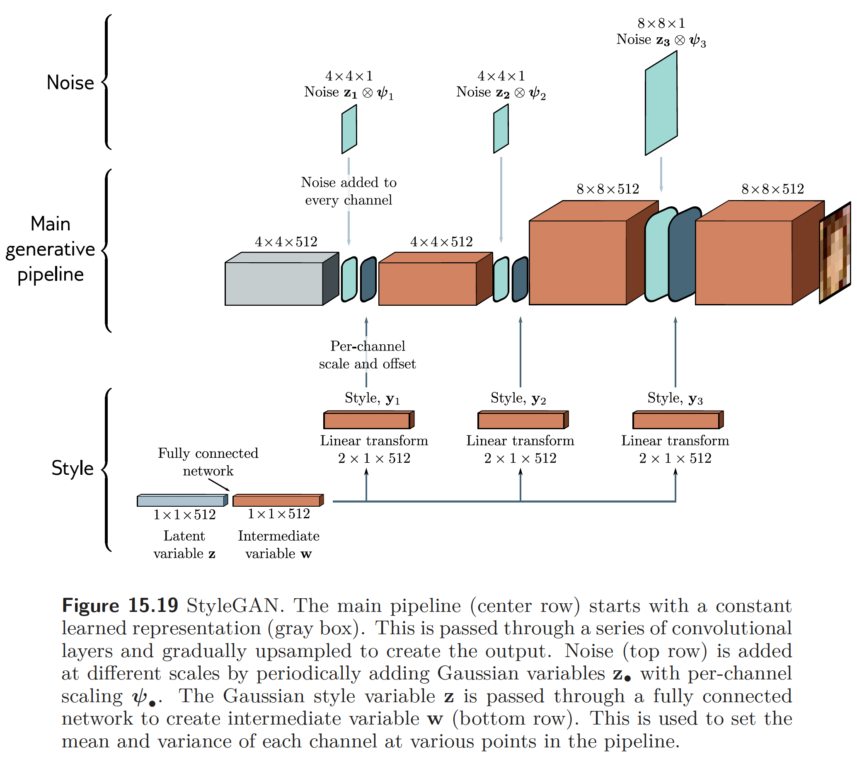
This work is subject to a Creative Commons CC-BY-NC-ND license. (C) MIT Press.

Slide 21
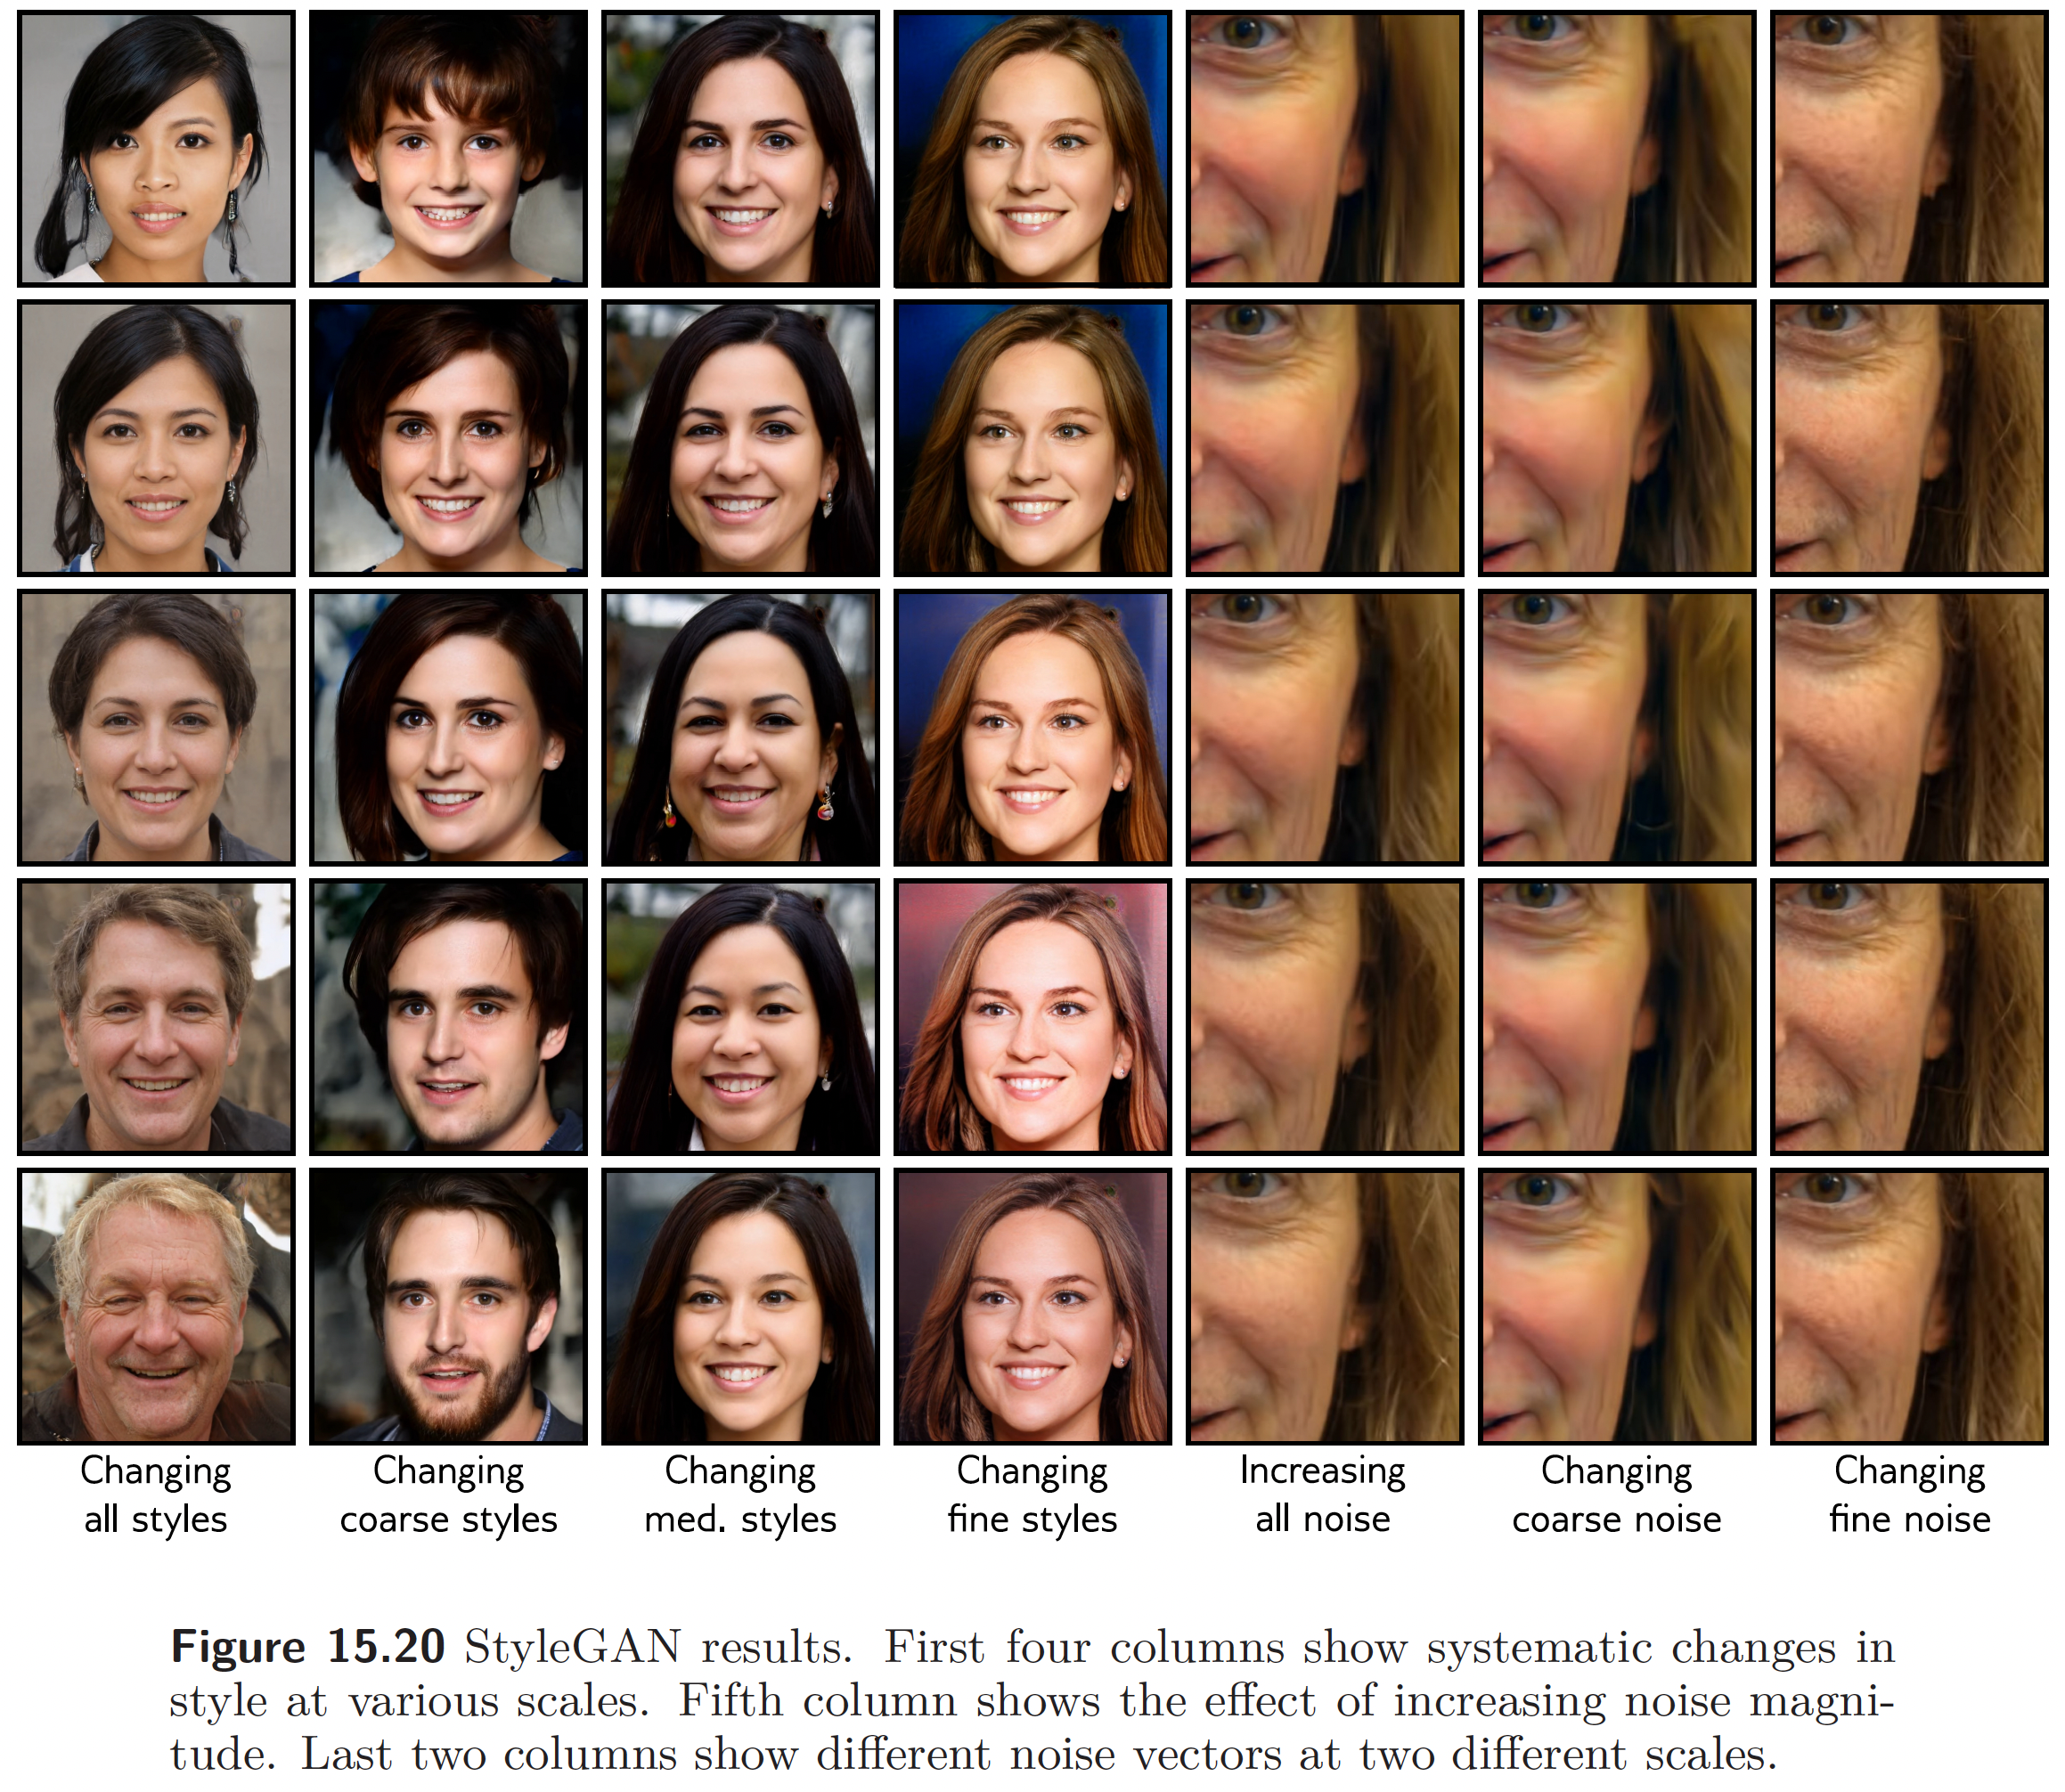
This work is subject to a Creative Commons CC-BY-NC-ND license. (C) MIT Press.

